Slide 1
Digital Security is for everyone
part Two
Shannon Turner
Twitter: @svthmc

Slide 2
Learn important settings that help keep your computer safe
Learn intermediate-level tools to help keep your computer safe
Notes:
This training is a continuation of the Security is for Everyone introductory training. If you haven’t taken Part One, you should take Part One first. As a reminder, we will cover the most common threats and how you can protect yourself.

Slide 3
Outline
Getting the most out of LastPass
Configuring your computer’s firewall
Encrypting your computer’s hard drive
Encrypting your phone’s hard drive
Browser extensions to keep you safer
Keeping safe when connecting to public WiFi
Using anti-virus software

Slide 4
Getting the most out of last pass

Slide 5
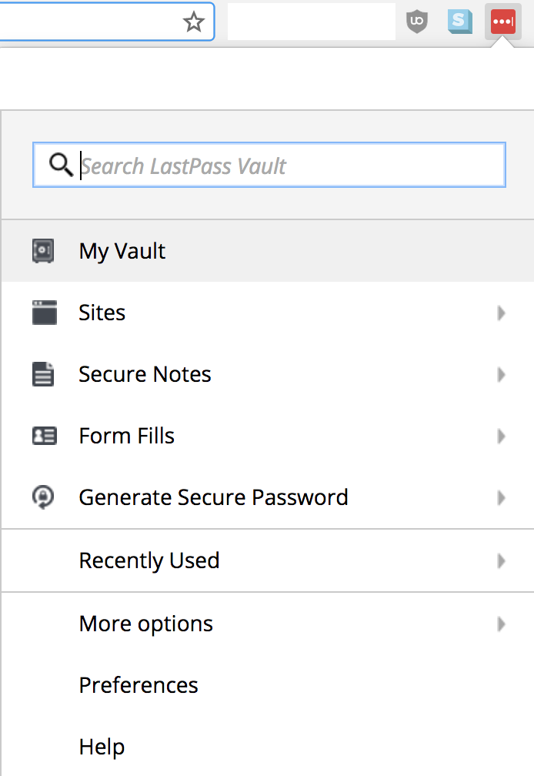
Get the most from last pass
Notes:
We’re going to assume you’ve installed the LastPass browser extension in these slides; if you have not installed LastPass or created an account yet, you’ll want to review Security is for Everyone Part One before continuing.
In your browser, click the LastPass logo to bring up the menu, then go to My Vault.

Slide 6
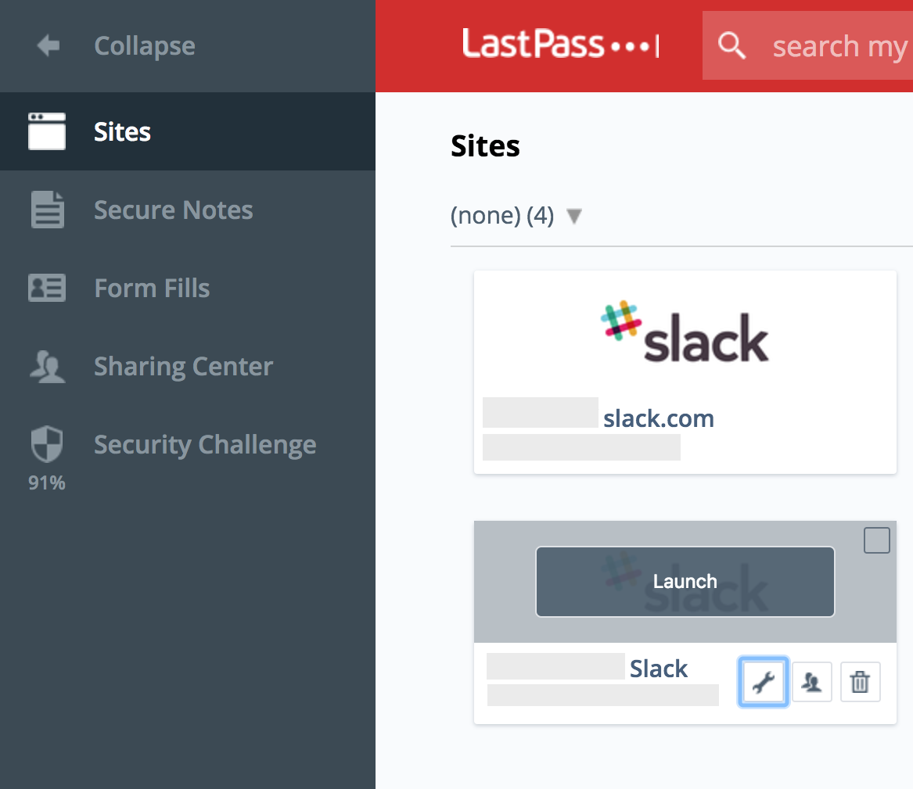
website logins you’ve saved
Notes:
Your Vault is where all of your data is stored, including all of the sites where you’ve saved passwords and secure notes like two-factor authentication recovery codes. Go to sites to view all of the sites where you’ve saved passwords. Here, they’re organized by which folder I’ve stored them in.
Click on the wrench to see and edit that site’s details.

Slide 7
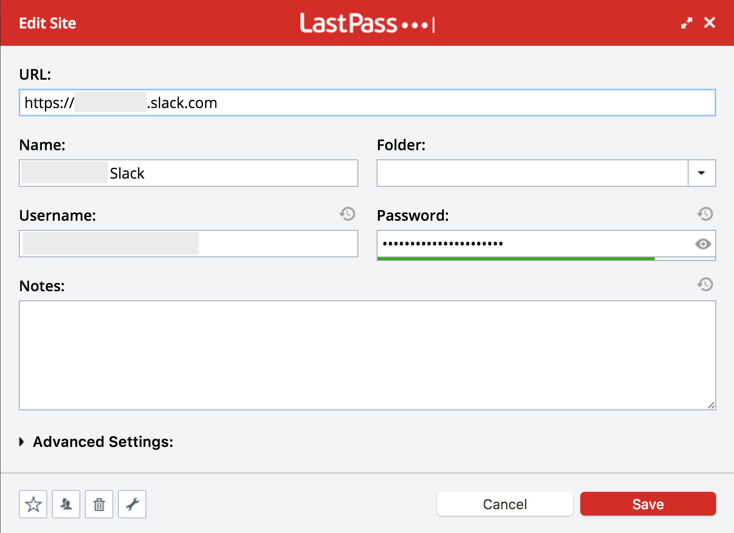
editing a saved website
Notes:
Clicking the wrench on the previous screen opens up a screen where we can edit a website that we have stored. Changing the folder a site is stored in can help you keep your passwords organized. You can also click the “eye” icon to view your password that you have saved with LastPass.

Slide 8
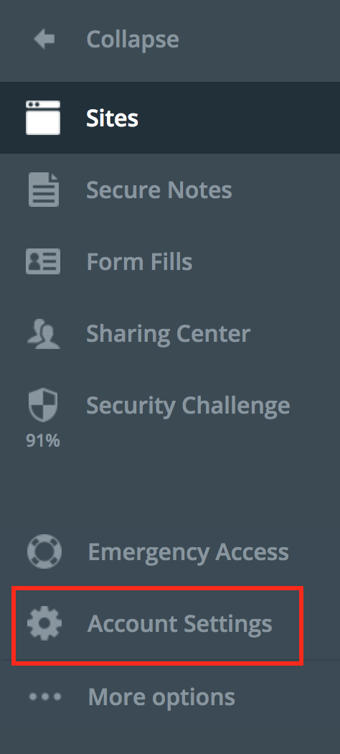
setting up two-factor authentication
Notes:
Setting up two-factor authentication with LastPass takes a few steps. To get started, click the Account Settings from inside your Vault.

Slide 9
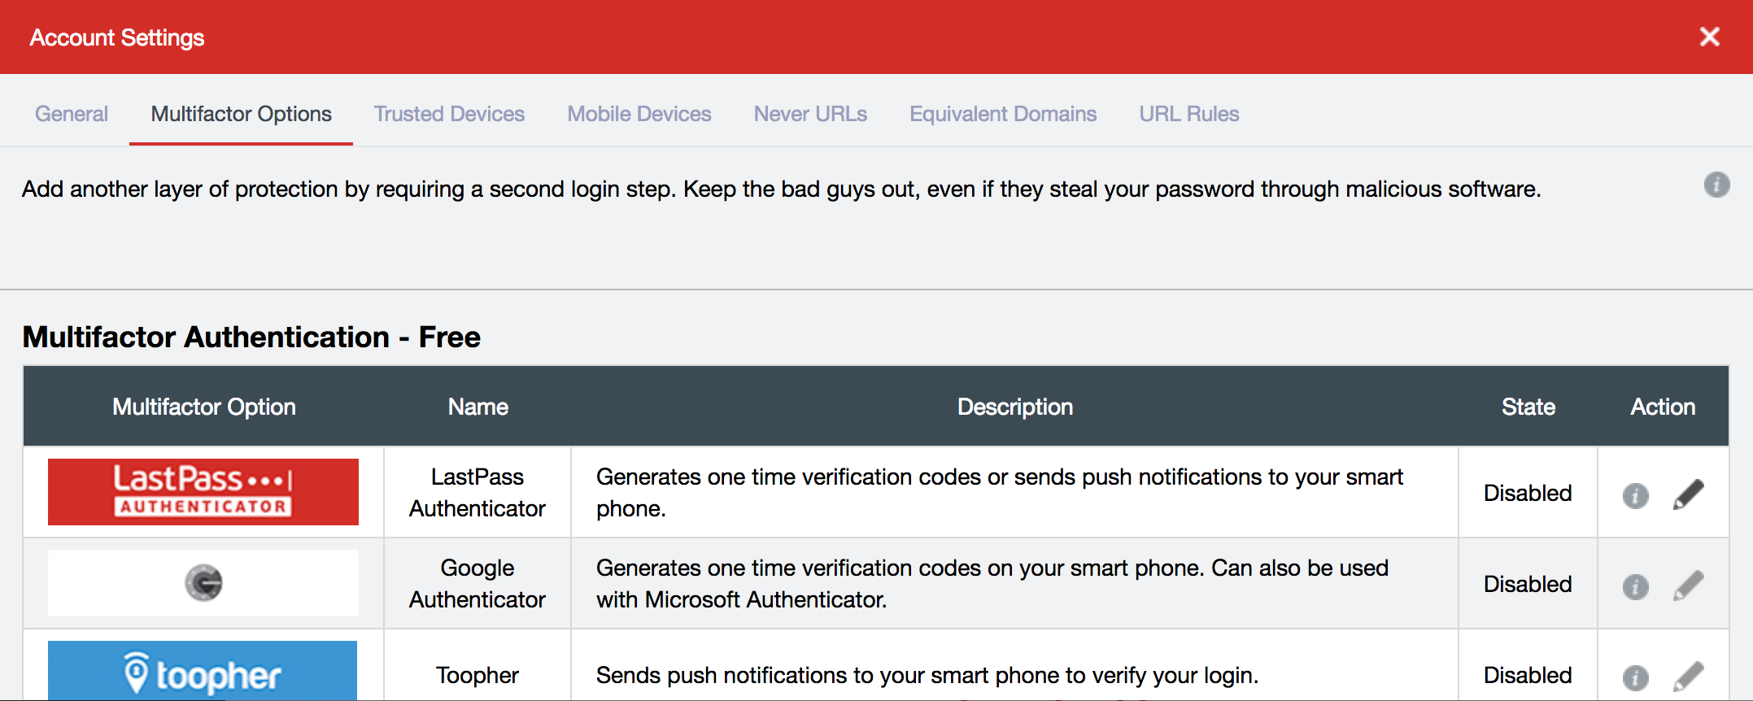
setting up two-factor authentication
Notes:
From the Account Settings screen, click Multifactor Options — this is what LastPass calls Two-Factor Authentication.
You have many options, but I would recommend the LastPass Authenticator or the Google Authenticator. Click the pencil and follow the prompts to continue. I won’t show all of the steps here, but it will walk you through it.

Slide 10
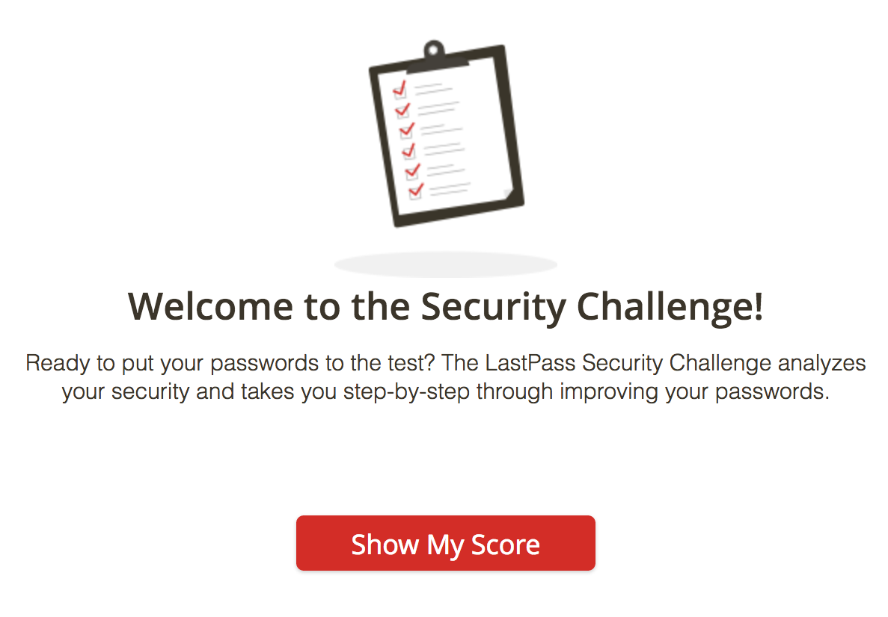
lastpass security challenge
Notes:
The LastPass security challenge will analyze how secure your passwords are and assign you a score. It will then walk you through how to improve your score and the security of your passwords. To get started, click on the Security Challenge button in the menu from your Vault.

Slide 11
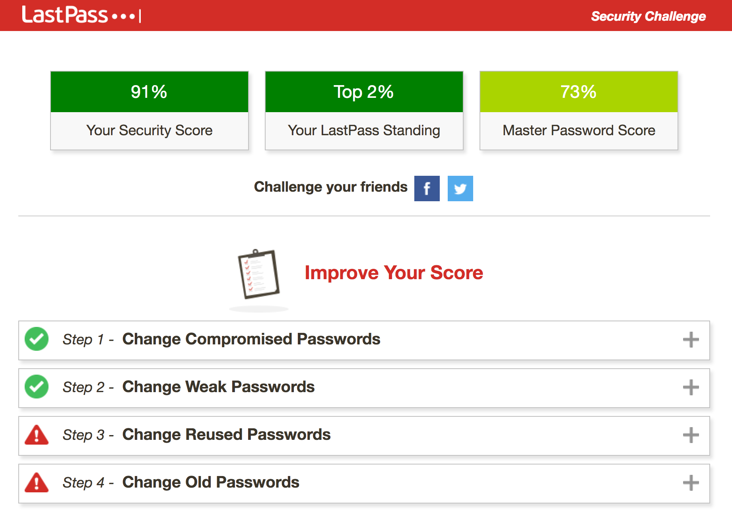
lastpass security challenge
Notes:
Here’s my security challenge - it shows my overall score and how strong my master password is, and gives me tips on what I can do to improve my score. Here, you can see that I have reused some passwords, and some of my passwords are old. If I click on Step 3 or Step 4, it will expand and give me options to improve those.

Slide 12
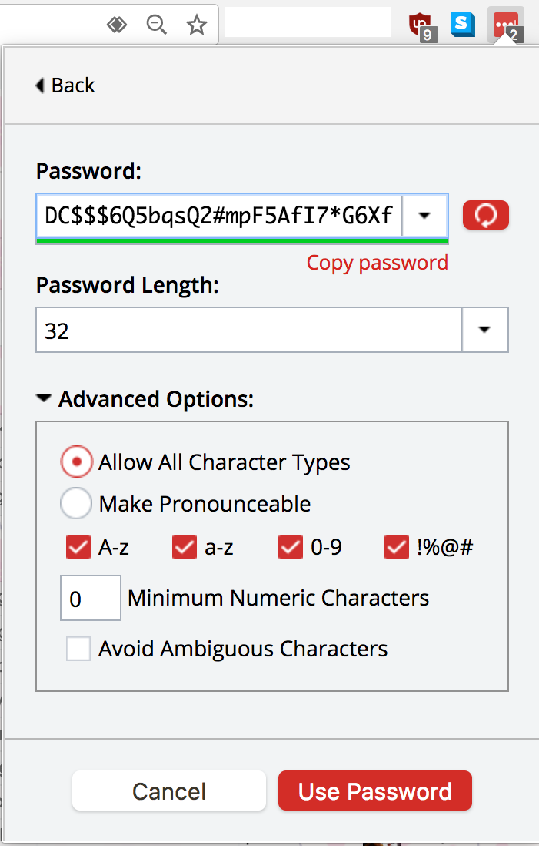
generating strong passwords
Notes:
You can use LastPass to generate secure passwords, and customize how strong you want the passwords to be. Here, I’ve created a password that’s 32 characters long, with upper and lowercase letters, numbers, and symbols. I wouldn’t ever be able to remember this password, but that’s okay because LastPass will keep it stored for me. To generate new passwords, click the lock that appears in the password field when you’re creating a new account, or click the LastPass icon in your browser and go to “Generate Secure Password.”

Slide 13
Configuring your computer’s firewall

Slide 14
Configuring your computer’s firewall
A firewall monitors your computer’s internet connection to make sure that only programs you’ve allowed can connect to the internet
If a program it doesn’t recognize tries to connect, it might mean you have a virus or someone is trying to attack your computer
Notes:
In other words, a firewall makes sure that in order to connect to the internet, your computer has your permission first. It might ask you for confirmation the first time it sees a program it doesn’t recognize. So for example, if I use Spotify to listen to music, the first time I run Spotify, my firewall might ask me if Spotify is allowed to connect to the internet. If I say yes, then the firewall will remember and won’t ask me again about Spotify. If I said no, then the firewall will prevent Spotify from connecting to the internet. If you don’t recognize the program your firewall asks about or aren’t sure, you’ll want to deny the request.

Slide 15
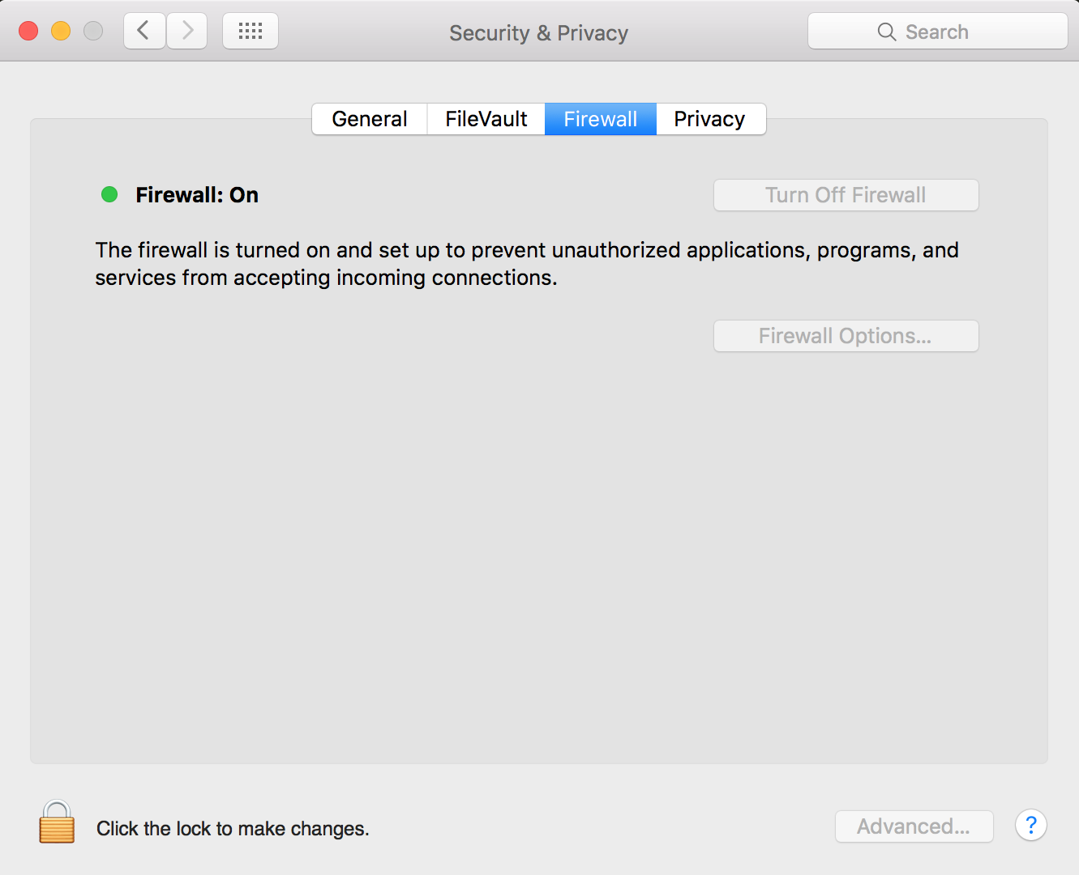
Configuring your computer’s firewall
Notes:
Here, you can see that I’ve turned on the Firewall on my Mac. To get to this screen, go to the Apple Menu > System Preferences > Security & Privacy (in the top row) and then click the Firewall tab. If your firewall is off, you’ll need to click the lock to make changes, enter your password, and click the button to turn on the firewall.

Slide 16
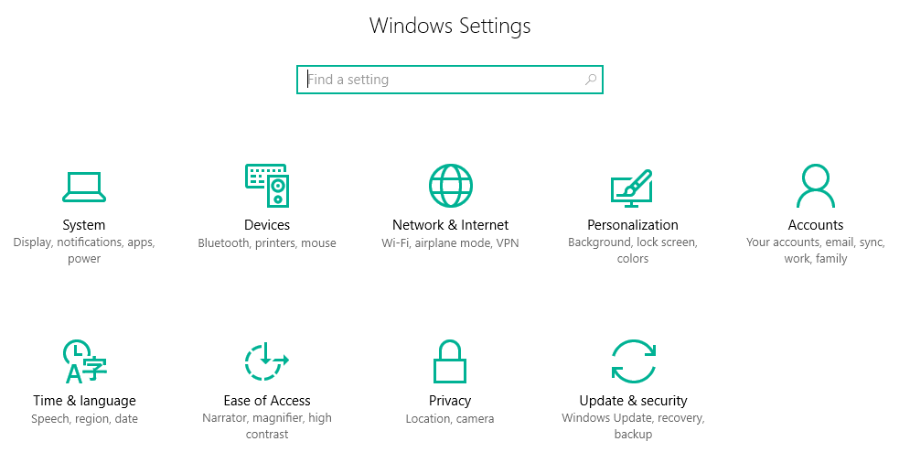
Configuring your computer’s firewall
Notes:
On Windows, click the Windows menu, then the small gear icon. This will open the Windows settings. Next, click Network & Internet.

Slide 17
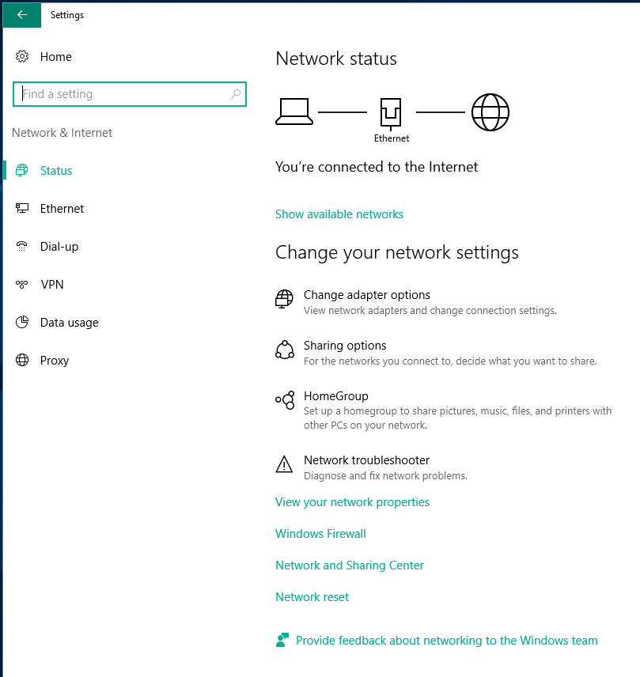
Configuring your computer’s firewall
Notes:
Toward the bottom of the Network status screen is Windows Firewall.

Slide 18
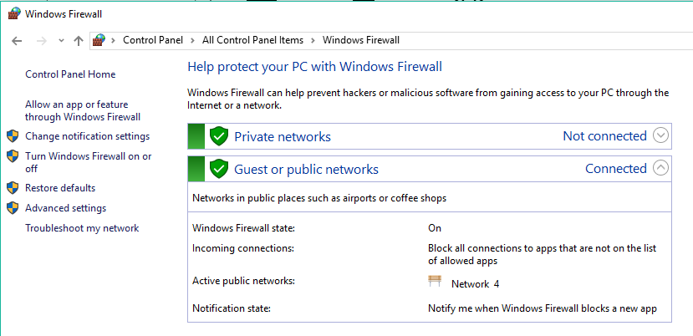
Configuring your computer’s firewall
Notes:
You’ll want to make sure that the firewall is on. Here, my settings will block any app that I haven’t allowed before, and Windows Firewall will tell me when it prevents a new app from connecting to the internet. You can customize these settings based on whether you’re on your home network or connected to a public network like a coffee shop.

Slide 19
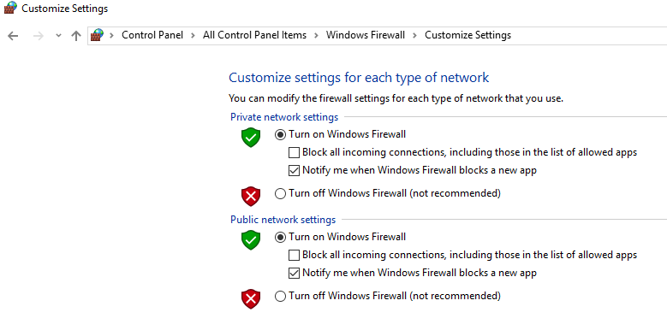
Configuring your computer’s firewall
Notes:
Here’s the customize settings screen, with the settings I would recommend. Private networks are like your home network where you trust all of the devices connected to it; public networks are networks like coffee shop wifi.

Slide 20
Encrypting your data

Slide 21
encrypting your data
Encrypting your computer and phone can protect from thieves
Encryption scrambles your data so it can’t be read without your password
Having a strong password is important!
Notes:
One thing to note is that if you haven’t encrypted your device’s data yet, it’s a process that can take a little bit of time, so you’ll want to make sure that you’re at home and plugged in and won’t need to use your computer or phone for a little while.

Slide 22
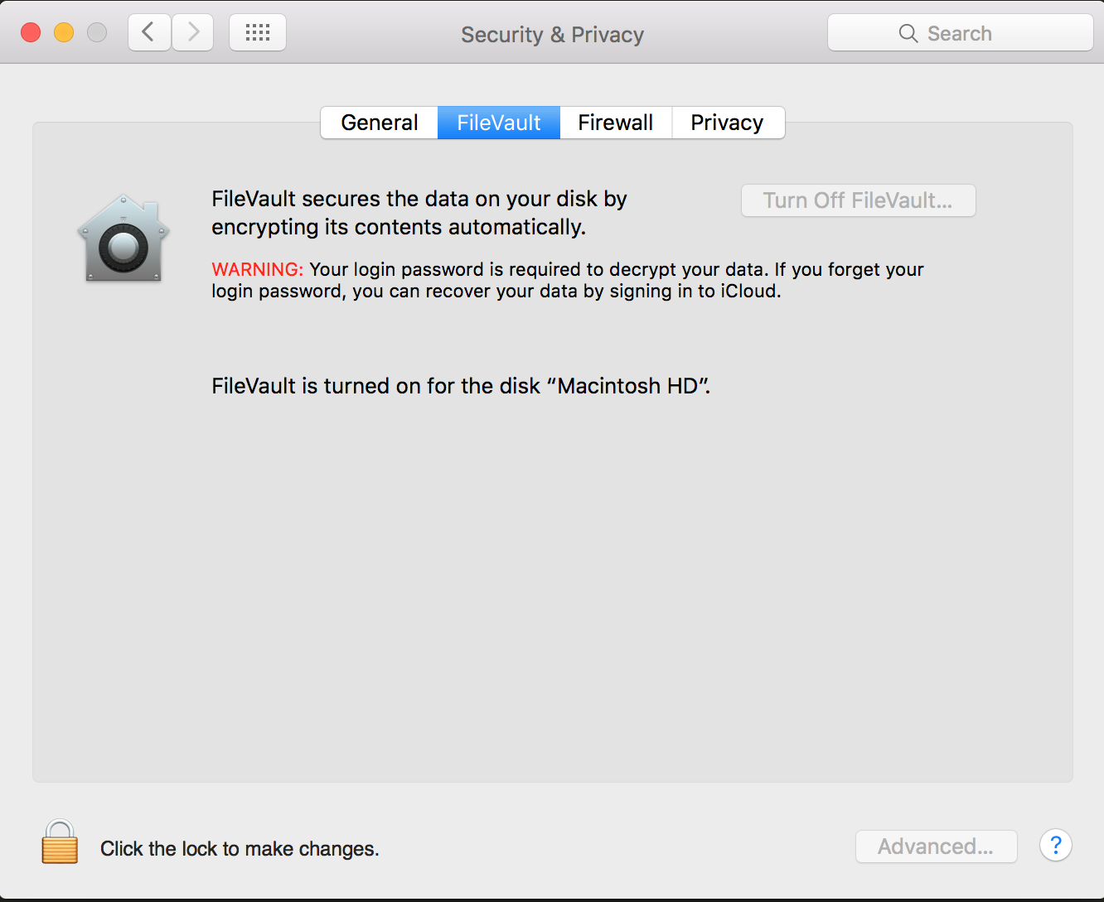
encrypting your data
Notes:
Apple calls disk encryption FileVault, and to turn it on, you’ll go to the Apple Menu > System Preferences > Security & Privacy (in the top row) > FileVault. If you see “FileVault is turned on for the disk” and the name of your hard drive, then you already have FileVault enabled. If not, it’s easy to set up. Click the lock to make changes, enter your login password, and click “Turn on FileVault.” Keep in mind that encrypting your files the first time will take a little while, so you’ll want to make sure that you’re at home and plugged in before you get started. You may need to restart your computer to complete this process.

Slide 23
encrypting your data
Encryption is not available on every version of Windows.
This guide can walk you through your options: http://www.howtogeek.com/234826/how-to-enable-full-disk-encryption-on-windows-10/
Notes:
Some versions of Windows do not offer disk encryption, but the guide linked here can walk you through if it’s available and show you a free third-party option that you can use if it’s not.

Slide 24
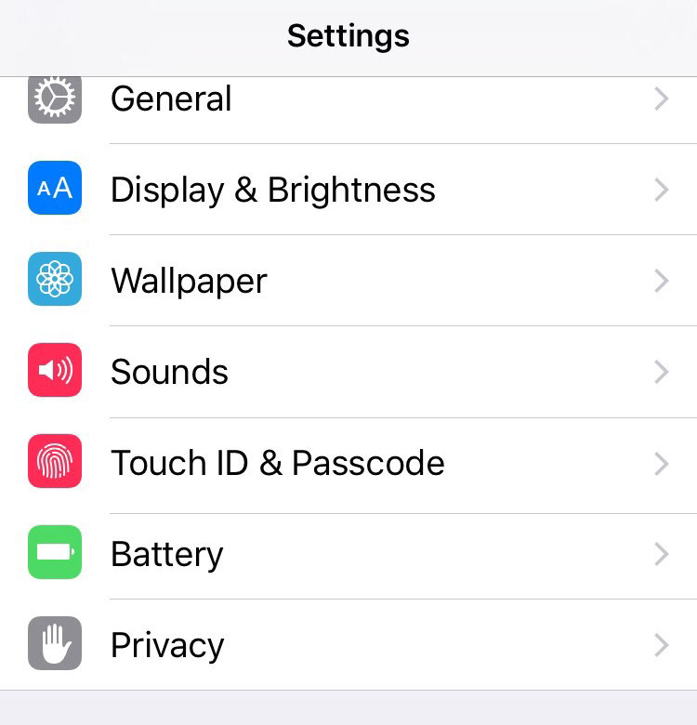
encrypting your phone
Notes:
If you have an iPhone, it’s probably encrypted already, but let’s check. Open your settings, then go to Touch ID & Passcode.

Slide 25
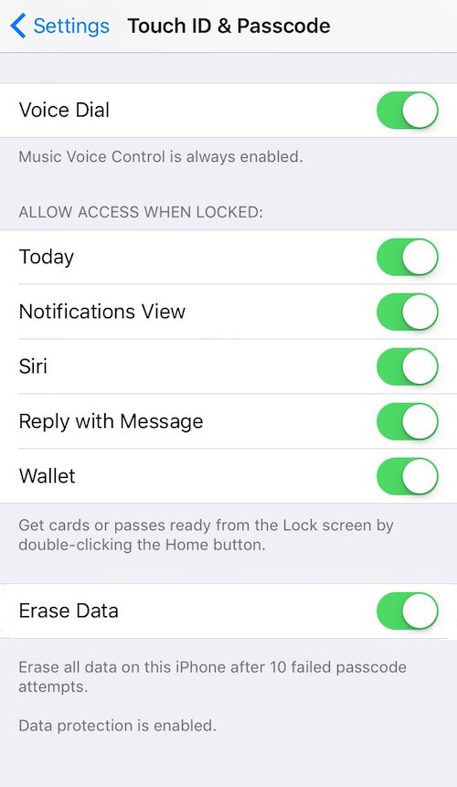
encrypting your phone
Notes:
It’ll prompt you for your password first, then scroll all the way to the bottom. If you see “Data protection is enabled,” then your iPhone is encrypted. You may want to consider turning on the “Erase Data” feature that appears just above the “Data protection is enabled.”
What does this do? Let’s say someone steals your phone. In theory, they could try every password in the book and eventually break in. (This is another reason having a strong password is a good thing!) If you have Erase Data turned on though, they would only get 10 chances to guess your password, and after that all of the data on your phone would be erased.
If you have young children who play with your phone often, you may not want to turn on the “Erase Data” feature.

Slide 26
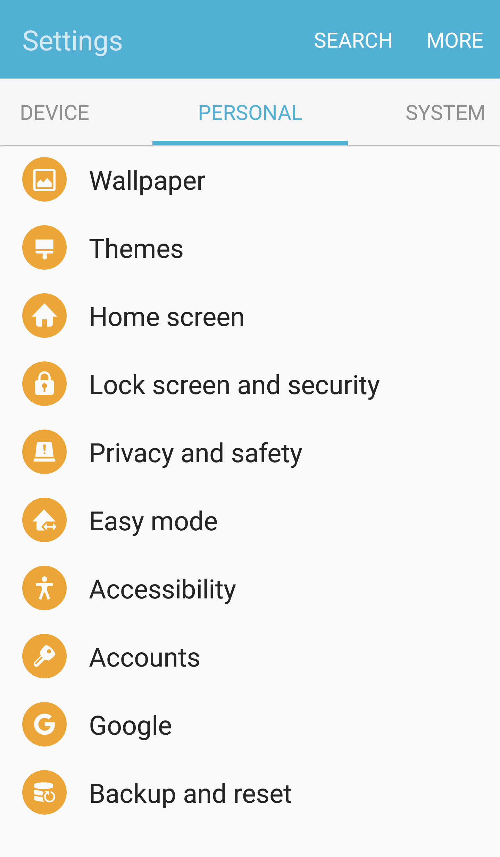
encrypting your phone
Notes:
To enable encryption on your Android, open your Settings, find the Personal tab, and go to Lock Screen and Security.

Slide 27
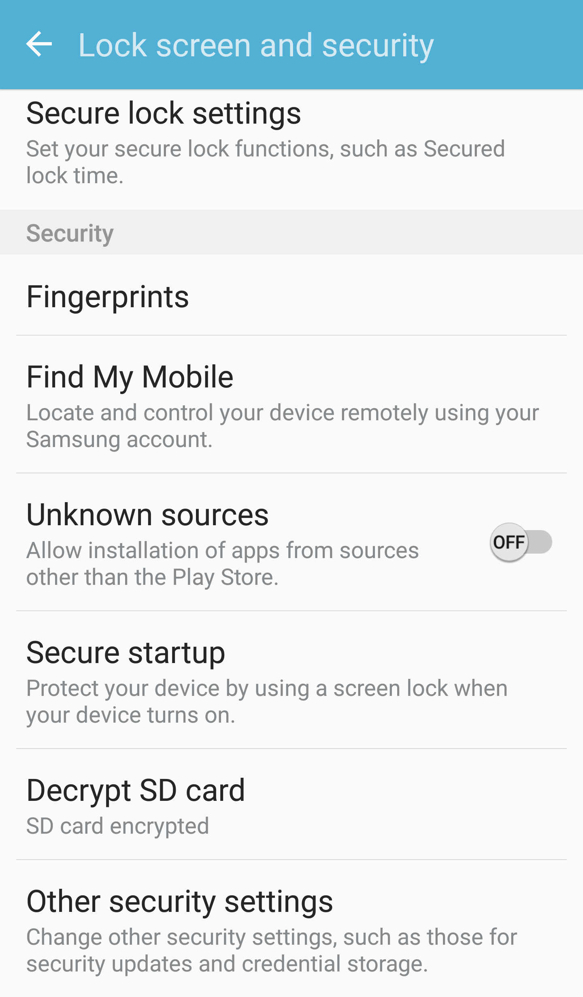
encrypting your phone
Notes:
The Lock screen and security page has many useful settings you’ll want to review but for now, click “Secure startup”

Slide 28
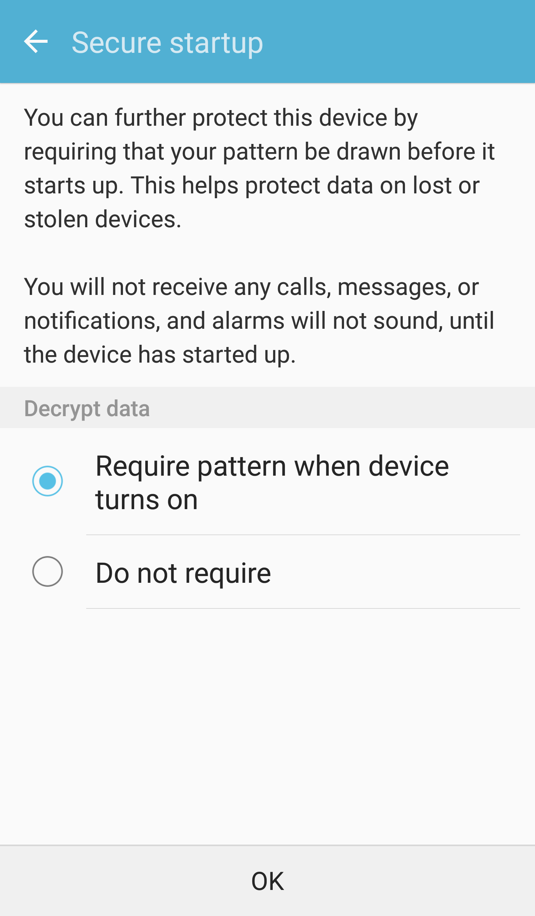
encrypting your phone
Notes:
Secure startup is what Android calls disk encryption, and you’ll want to require your pattern or password when the device turns on. If you’re turning this on for the first time, keep in mind it can take a little while to enable, and that you’ll want to make sure that you’re plugged in before you get started.
An important note: if you have an SD card, you will need to encrypt that separately from your phone’s main hard drive.

Slide 29
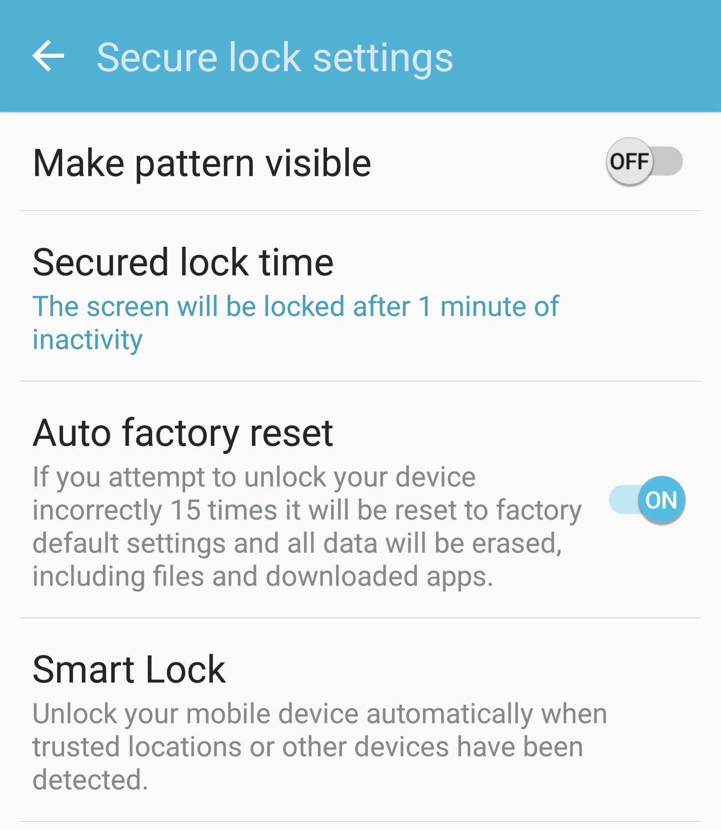
encrypting your phone
Notes:
While we’re in the Lock Screen & Security page, let’s take a look at the Secure lock settings. Here, I have my phone set to lock after 1 minute of inactivity, and just like the iPhone “Erase data” feature, I have the “Auto factory reset” feature enabled so that someone can’t try every password in the book.

Slide 30
browser extensions to keep you safer

Slide 31
ublock origin ad blocker
Chrome: https://chrome.google.com/webstore/detail/ublock-origin/cjpalhdlnbpafiamejdnhcphjbkeiagm?hl=en
Firefox: https://addons.mozilla.org/en-us/firefox/addon/ublock-origin/
Notes:
Ads can track which websites you’ve visited and are not merely intrusive from a privacy perspective; they can also be a security risk. Malicious ads can infect your computer with a virus, so blocking them with a trusted ad blocker can keep you safe. You may notice that UBlock blocks things like social media buttons in addition to advertisements. You can also turn it off on a per-site basis if you like.
These are links that will let you download a browser extension for either Chrome or Firefox.

Slide 32
https everywhere
Chrome: https://chrome.google.com/webstore/detail/https-everywhere/gcbommkclmclpchllfjekcdonpmejbdp?hl=en
Firefox: https://addons.mozilla.org/en-US/firefox/addon/https-everywhere/
Notes:
HTTPS Everywhere is a browser extension that can change some insecure HTTP requests into secure HTTPS requests. It’s not perfect and if a website isn’t configured to use HTTPS at all, it *will not* make that connection between your website and the computer secure.

Slide 33
Keeping safe on public wifi

Slide 34
what could go wrong?
Hackers could be on the public network too
Whoever is on the network can see everyone else who is connected and could monitor non-secure internet traffic
Attackers could create a “lookalike” network, then monitor the traffic of everyone who connects

Slide 35
keeping safe on public wifi
Enable your Firewall!
Connect via HTTPS where available (HTTPS Everywhere can help)
Disable network discovery and sharing
Use a VPN (Virtual private network)
Notes:
If you’ve been following along with this training start to finish, you have already completed the first two steps: enabling your computer’s firewall and installing the HTTPS Everywhere browser extension. There’s two more things we should do to protect ourselves when connecting to public wifi, and in the next few slides we’ll show how to do those.
If you’re on a public Wifi and not connecting via HTTPS, it’s possible for someone to intercept your internet traffic.

Slide 36
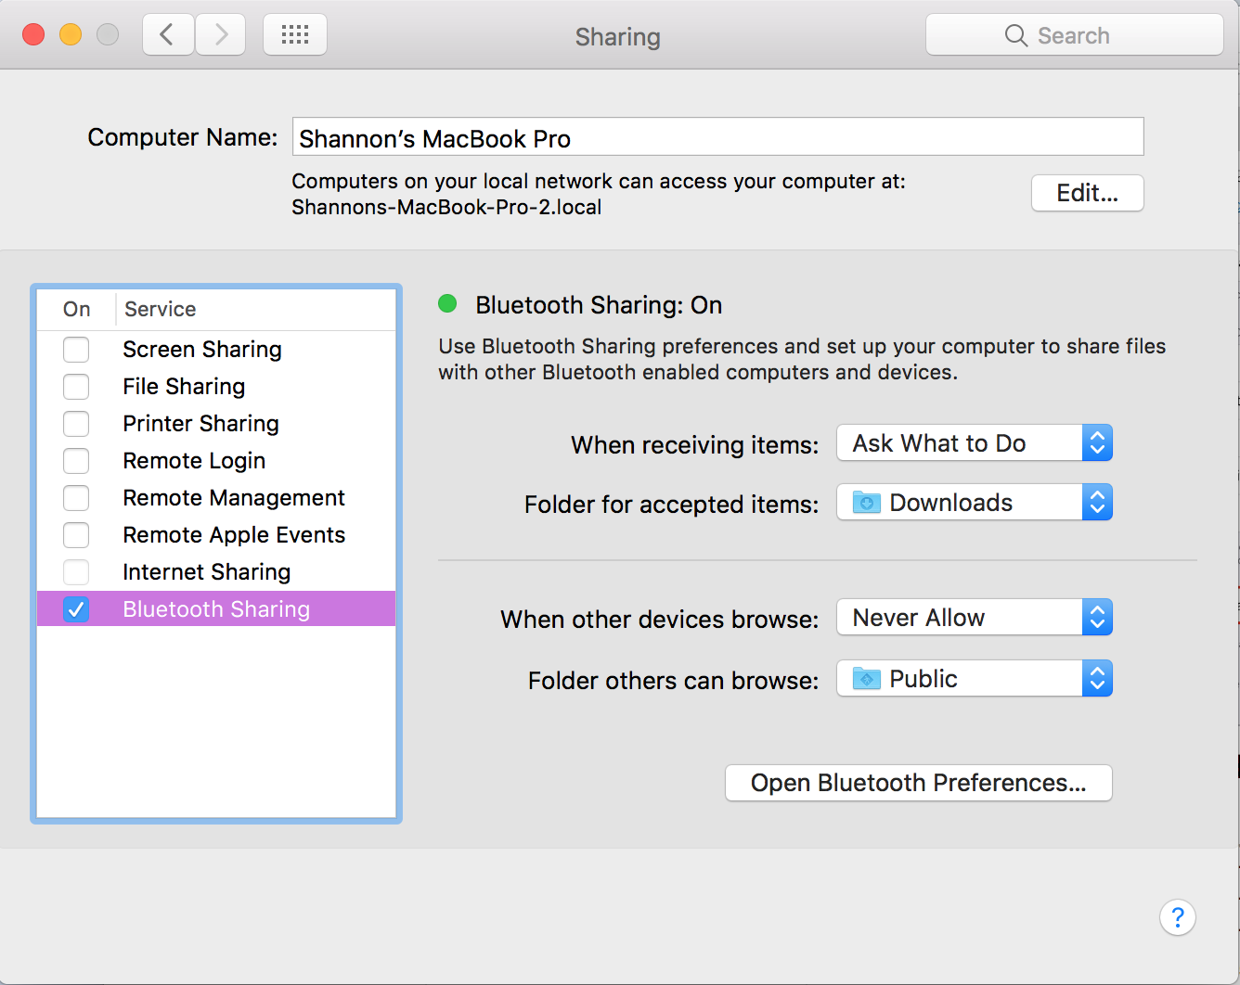
disable network discovery and sharing
Notes:
Usually, the sharing settings are off by default — that’s a good thing! While sharing can be a useful feature in some situations, it can also leave your computer vulnerable if the settings are too permissive. Check your computer’s settings by going to the Apple Menu > System Preferences > Sharing (in the third row). Each type of sharing (Screen Sharing, File Sharing, Printer Sharing, Remote Login, and so on) has its own set of permissions to configure. Here, I have all of them turned off except for Bluetooth Sharing, which I was using when creating this slideshow to send pictures from my phone to my computer. If all of the checkboxes are unchecked, that’s good — it means you’re not using these features.
If you do decide to use these features, make sure you configure them carefully, understand what you’re doing, and turn them off if you no longer need them. This is a good idea not just for keeping yourself safe on public wifi, but generally.

Slide 37
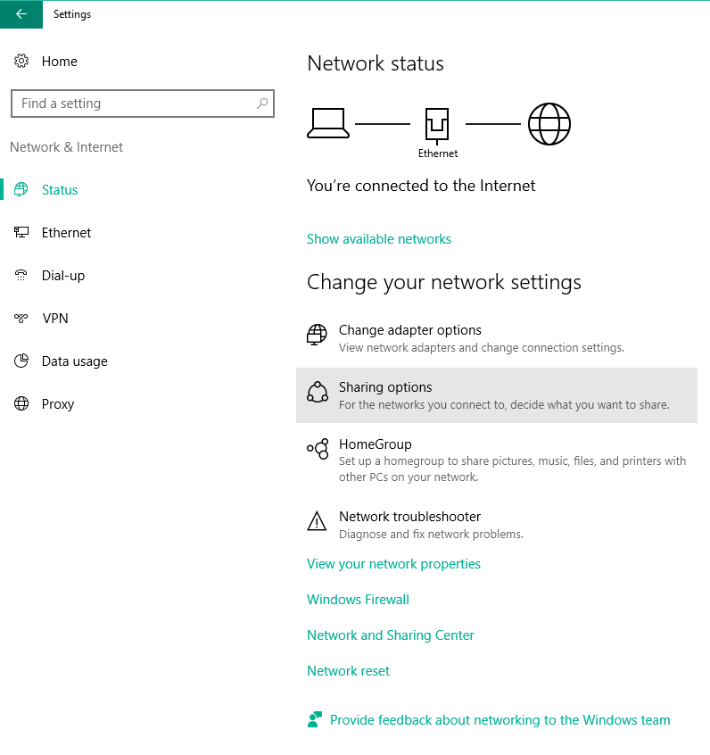
disable network discovery and sharing
Notes:
On Windows, open the settings as seen earlier, and go to the Network status window. This time, go to the Sharing options as seen in the highlighted screenshot.

Slide 38
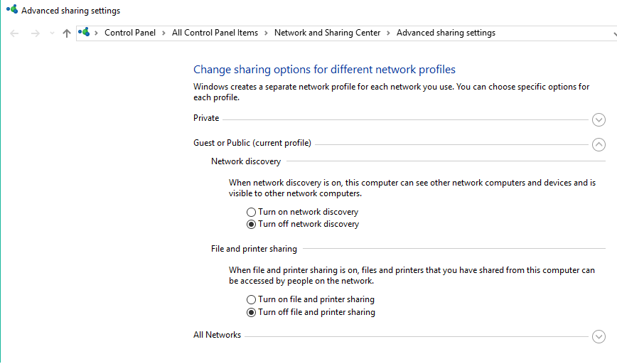
disable network discovery and sharing
Notes:
In this window you will be able to configure your network settings based on which type of network you’re connected to. You might want a different set of permissions if you’re on your home network versus if you’re at a coffeeshop. In this screenshot, I’m configuring the settings for a public network like that you would use at a coffeeshop. I’ve chosen to turn off network discovery and turn off file and printer sharing.
What that means is that my computer won’t be visible to other computers on this network, and that any files I’ve put in a share folder won’t be accessible to computers on this network.

Slide 39
what’s a virtual private network do?
You connect to the VPN, and the VPN connects to the websites you visit
Prevent your internet activity from being tracked by your network and your internet service provider
Notes:
Your internet service provider will be able to see that you are connecting to a VPN but won’t be able to tell anything beyond that.

Slide 40
what’s a virtual private network do?
Avoid blocked or region-restricted websites by faking your location
Keeps you safe when connected to public wifi
Notes:
As long as your connection to your VPN is secure, the VPN will keep your traffic from being intercepted by anyone else on the public wifi.

Slide 41
virtual private networks (VPN)
There are many services that offer VPNs
Some options include: https://privacytoolsio.github.io/privacytools.io/#vpn
Whatever service you use, make sure you trust them!
Notes:
There are a lot of different VPNs out there - the ones linked here are just a few services. This page has a LOT of information and is aimed at advanced users, but I found it very informative so I wanted to include it. Which VPN you use is up to you and your specific needs and threat models.

Slide 42
Anti-Virus Software

Slide 43
Anti-virus software
Anti-virus software can protect your computer by blocking viruses and other kinds of malicious programs (malware)
Yes, even Macs can get viruses.

Slide 44
Anti-virus software
Visiting malicious websites and downloading counterfeit software are common ways you can get a virus
Ad blockers can help but for an added layer of protection, you’ll want to get anti-virus software

Slide 45
Anti-virus software
Many anti-virus providers have a free service, but some are paid.
I use https://www.avast.com/
Most importantly: keep your software up to date!

Slide 46
continue learning
Resources and additional trainings will be added here periodically.

